Slide 1
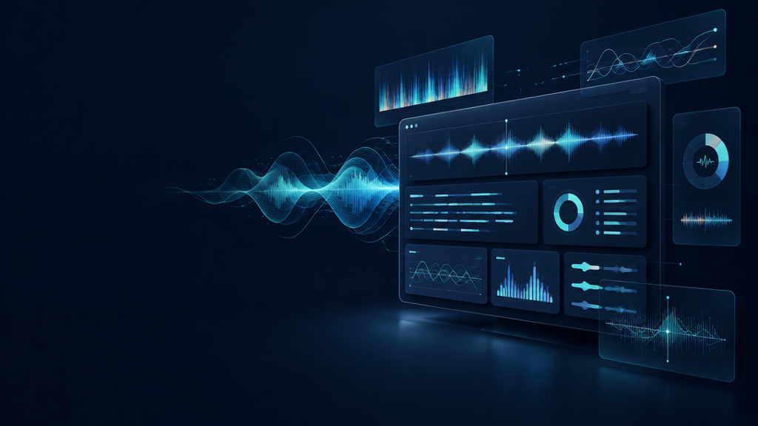
Call Center Agent
Performance Analysis
Speech-to-Insights Pipeline

Slide 2
From recording to reviewable insight
One workflow turns raw conversation into evidence a reviewer can inspect.
Understand
the conversation
Identify
the experience
Make results
reviewable
A traceable path from audio → transcript → structured interpretation

Slide 3
Dataset research narrowed by evidence
11 public datasets surveyed; selection prioritized fit, references, and evaluation readiness.
11
SURVEYED
Call-center relevance
4
Speaker/reference availability
SHORTLISTED
Evaluation compatibility
1
SELECTED

Slide 4
A constraint-led model selection journey
Exploration informed the architecture; this was not a controlled benchmark comparison.
EXPLORED
CONSTRAINT
ADOPTED
Microsoft
VibeVoice-ASR
Local hardware +
inference limits
WhisperX modular
pipeline
Decision basis: deployability, modular alignment, and diarization workflow — not a claim of head-to-head quality superiority.

Slide 5
Speech becomes attributable turns
Diarization creates speaker IDs; role inference later maps them to Customer or Agent.
SPEAKER_00
00:04–00:11
role inferred later
SPEAKER_01
00:12–00:19
role inferred later
Speaker identity ≠ business role
SPEAKER_00
00:20–00:27
role inferred later

Slide 6
LLM-powered call understanding
A compact schema converts the speaker-aware transcript into reviewable business fields.
{
"speaker_roles": { ... },
"issue": "...",
"action": "...",
"outcome": "...",
"customer_sentiment": "..."
}
ISSUE
What prompted the call
ACTION
What the agent did
OUTCOME + SENTIMENT
Resolution and customer tone

Slide 7
End-to-end architecture
Online analysis and offline reference evaluation share the same transcript backbone.
Offline evaluation
transcripts + references
Audio
upload
WhisperX
ASR
Word
alignment
Speaker
diarization
Speaker-labeled transcript with timestamps
Groq / GPT-OSS 20B
summarieztion and sentiment
Streamlit
dashboard

Slide 8
Evaluation framework
Four complementary measures separate recognition, attribution, and efficiency.
WER ↓
14.66%
CER ↓
9.92%
Word-level ASR errors
Character-level ASR errors
DER ↓
11.04%
RTF ↓
0.1694×
Speaker attribution errors
Processing time ÷ audio time

Slide 9
Results on 100 calls
Completion is reported separately for speech processing and downstream interpretation.
100 / 100
100 / 100
89 / 100
Transcription completed
Diarization completed
Downstream LLM analysis completed
11 calls did not complete downstream LLM analysis. WER, CER, DER, and RTF values are not stated here because no metric export was provided in the assessment brief.

Slide 10
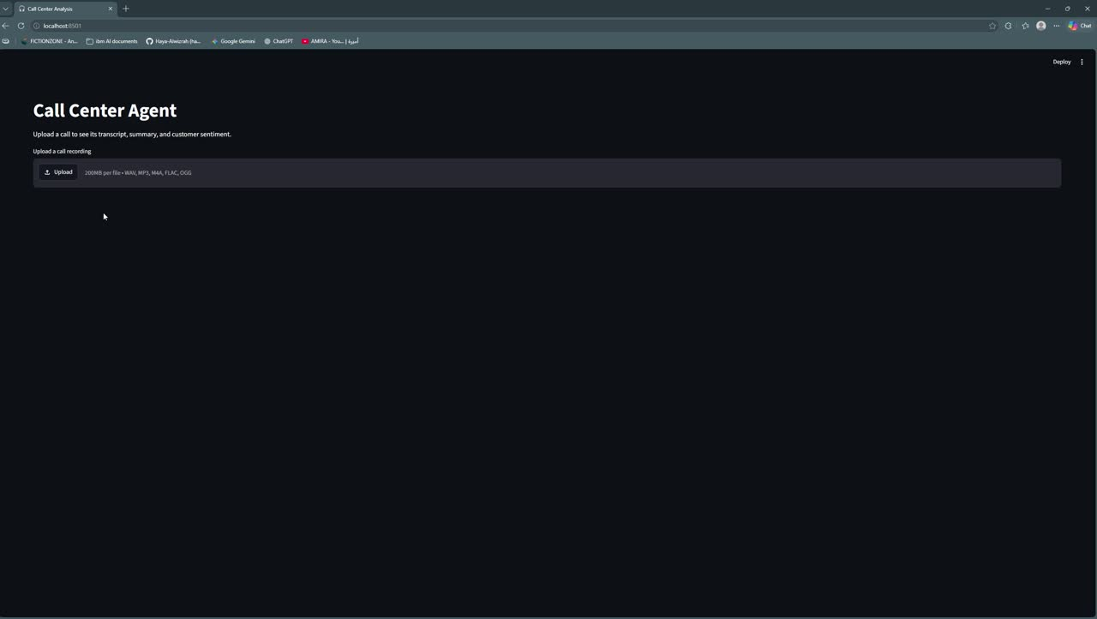
Streamlit demo
A 60-second walkthrough: upload → review → inspect speaker-separated evidence.

Slide 11
Built for reproducibility — ready for refinement
The value is the integrated, inspectable workflow: speech processing, structured understanding, and explicit evaluation.
REPRODUCIBLE
Modular stages and structured outputs
INTEGRATED
One path from audio to dashboard
EVALUATED
Reference-aware speech metrics
Next: harden retries • preserve metric exports • expand labeled references

